Slide 1
Software Engineering
Prepared by : Neha Tripathi

Slide 2
Agile Software Development- eXtreme Programming(XP)
Agile methods are incremental development methods that focus on rapid development, frequent releases of the software, reducing process overheads and producing high-quality code. They involve the customer directly in the development process.
The decision on whether to use an agile or a plan-driven approach to development should depend on the type of software being developed, the capabilities of the development team and the culture of the company developing the system.
Extreme programming is a well-known agile method that integrates a range of good programming practices such as frequent releases of the software, continuous software improvement and customer participation in the development team.

Slide 3
eXtreme Programming(XP)
Perhaps the best-known and most widely used agile method.
Extreme Programming (XP) takes an ‘extreme’ approach to iterative development.
New versions may be built several times per day;
Increments are delivered to customers every 2 weeks;
All tests must be run for every build and the build is only accepted if tests run successfully.

Slide 4
XP and agile principles
Incremental development is supported through small, frequent system releases.
Customer involvement means full-time customer engagement with the team.
People not process through pair programming, collective ownership and a process that avoids long working hours.
Change supported through regular system releases.
Maintaining simplicity through constant refactoring of code.

Slide 5
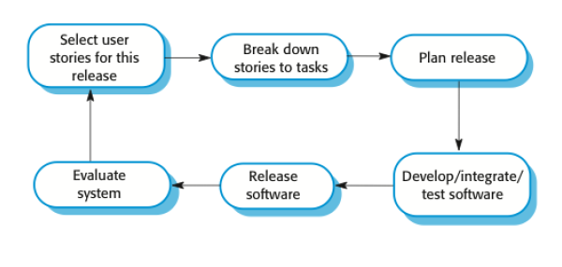
The Extreme Programming release cycle

Slide 6
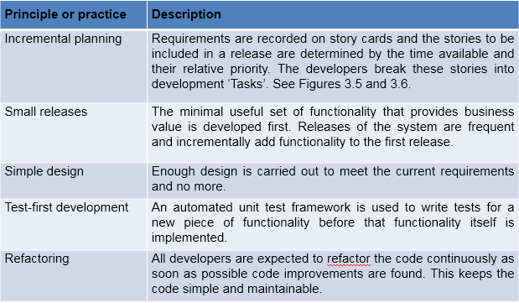
Extreme programming practices (a)

Slide 7
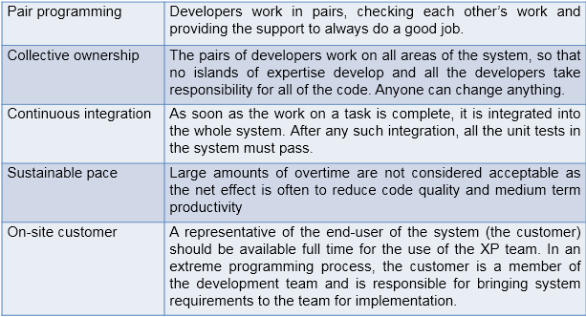
Extreme programming practices (b)

Slide 8
Requirements scenarios
In XP, a customer or user is part of the XP team and is responsible for making decisions on requirements.
User requirements are expressed as scenarios or user stories.
These are written on cards and the development team break them down into implementation tasks. These tasks are the basis of schedule and cost estimates.
The customer chooses the stories for inclusion in the next release based on their priorities and the schedule estimates.

Slide 9
Refactoring
Programming team look for possible software improvements and make these improvements even where there is no immediate need for them.
This improves the understandability of the software and so reduces the need for documentation.
Changes are easier to make because the code is well-structured and clear.
However, some changes requires architecture refactoring and this is much more expensive.
Example: Tidying up and renaming attributes and methods to make them easier to understand.

Slide 10
Test-first development
Writing tests before code clarifies the requirements to be implemented.
Tests are written as programs rather than data so that they can be executed automatically. The test includes a check that it has executed correctly.
Usually relies on a testing framework such as Junit.
All previous and new tests are run automatically when new functionality is added, thus checking that the new functionality has not introduced errors.

Slide 11
Pair programming
In XP, programmers work in pairs, sitting together to develop code.
This helps develop common ownership of code and spreads knowledge across the team.
It serves as an informal review process as each line of code is looked at by more than 1 person.
It encourages refactoring as the whole team can benefit from this.
Measurements suggest that development productivity with pair programming is similar to that of two people working independently.
In pair programming, programmers sit together at the same workstation to develop the software.
Pairs are created dynamically so that all team members work with each other during the development process.
The sharing of knowledge that happens during pair programming is very important as it reduces the overall risks to a project when team members leave.
Pair programming is not necessarily inefficient and there is evidence that a pair working together is more efficient than 2 programmers working separately.

Slide 12
Advantages of pair programming
It supports the idea of collective ownership and responsibility for the system.
Individuals are not held responsible for problems with the code. Instead, the team has collective responsibility for resolving these problems.
It acts as an informal review process because each line of code is looked at by at least two people.
It helps support refactoring, which is a process of software improvement.
Where pair programming and collective ownership are used, others benefit immediately from the refactoring so they are likely to support the process.

Slide 13
Thank You!

